Slide 1
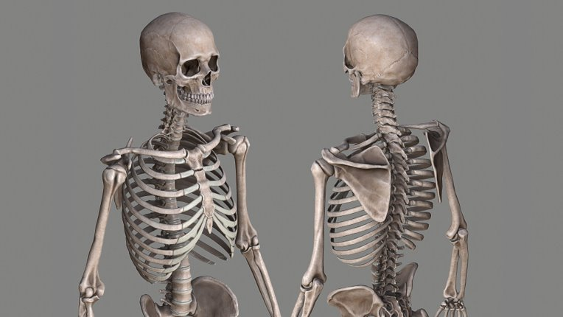
Project II Mid-Report
Team: Skeletons
Jake G. Chau P. Afam U.

Slide 2
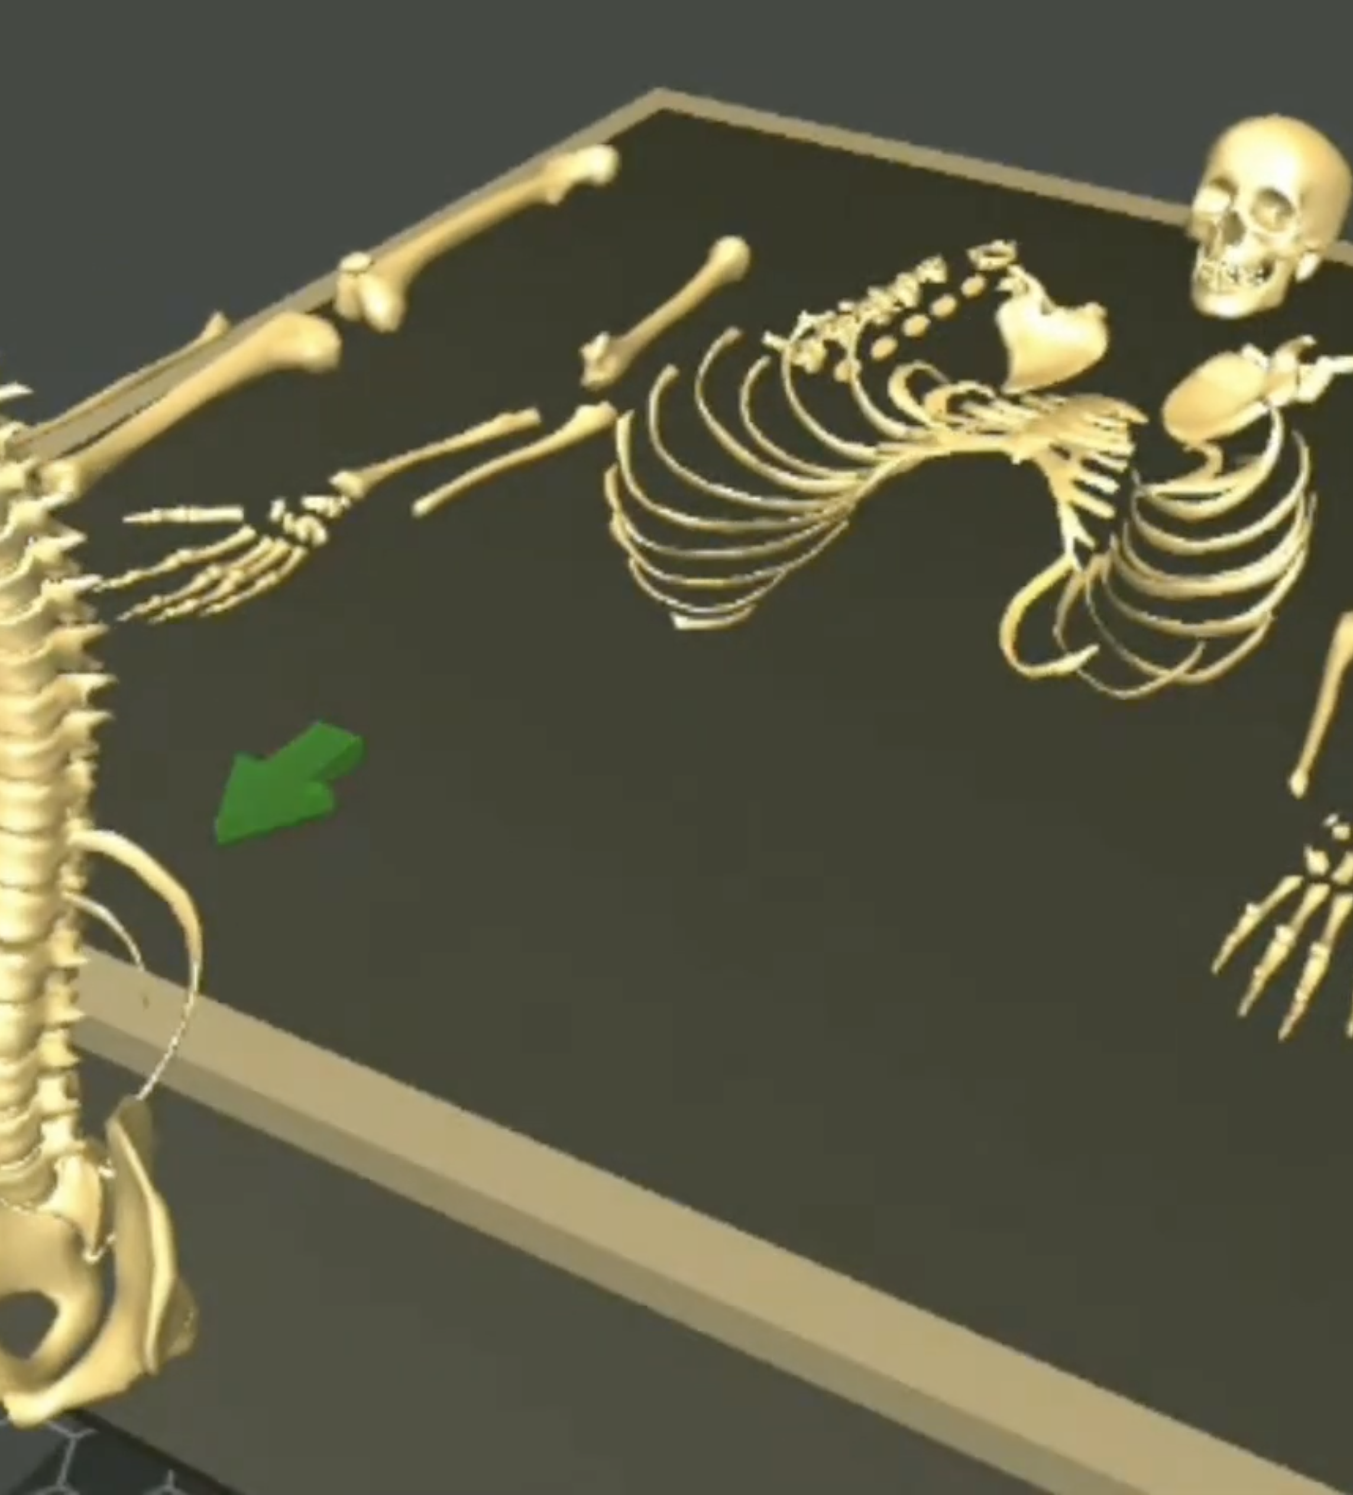
Project Overview
Puzzle game aiming to educate players about skeletal system
Players assemble a human skeleton using virtual reality controllers
Information about bones and skeletal system is displayed to the user to facilitate learning
Main idea of the project (Picture from [1])

Slide 3
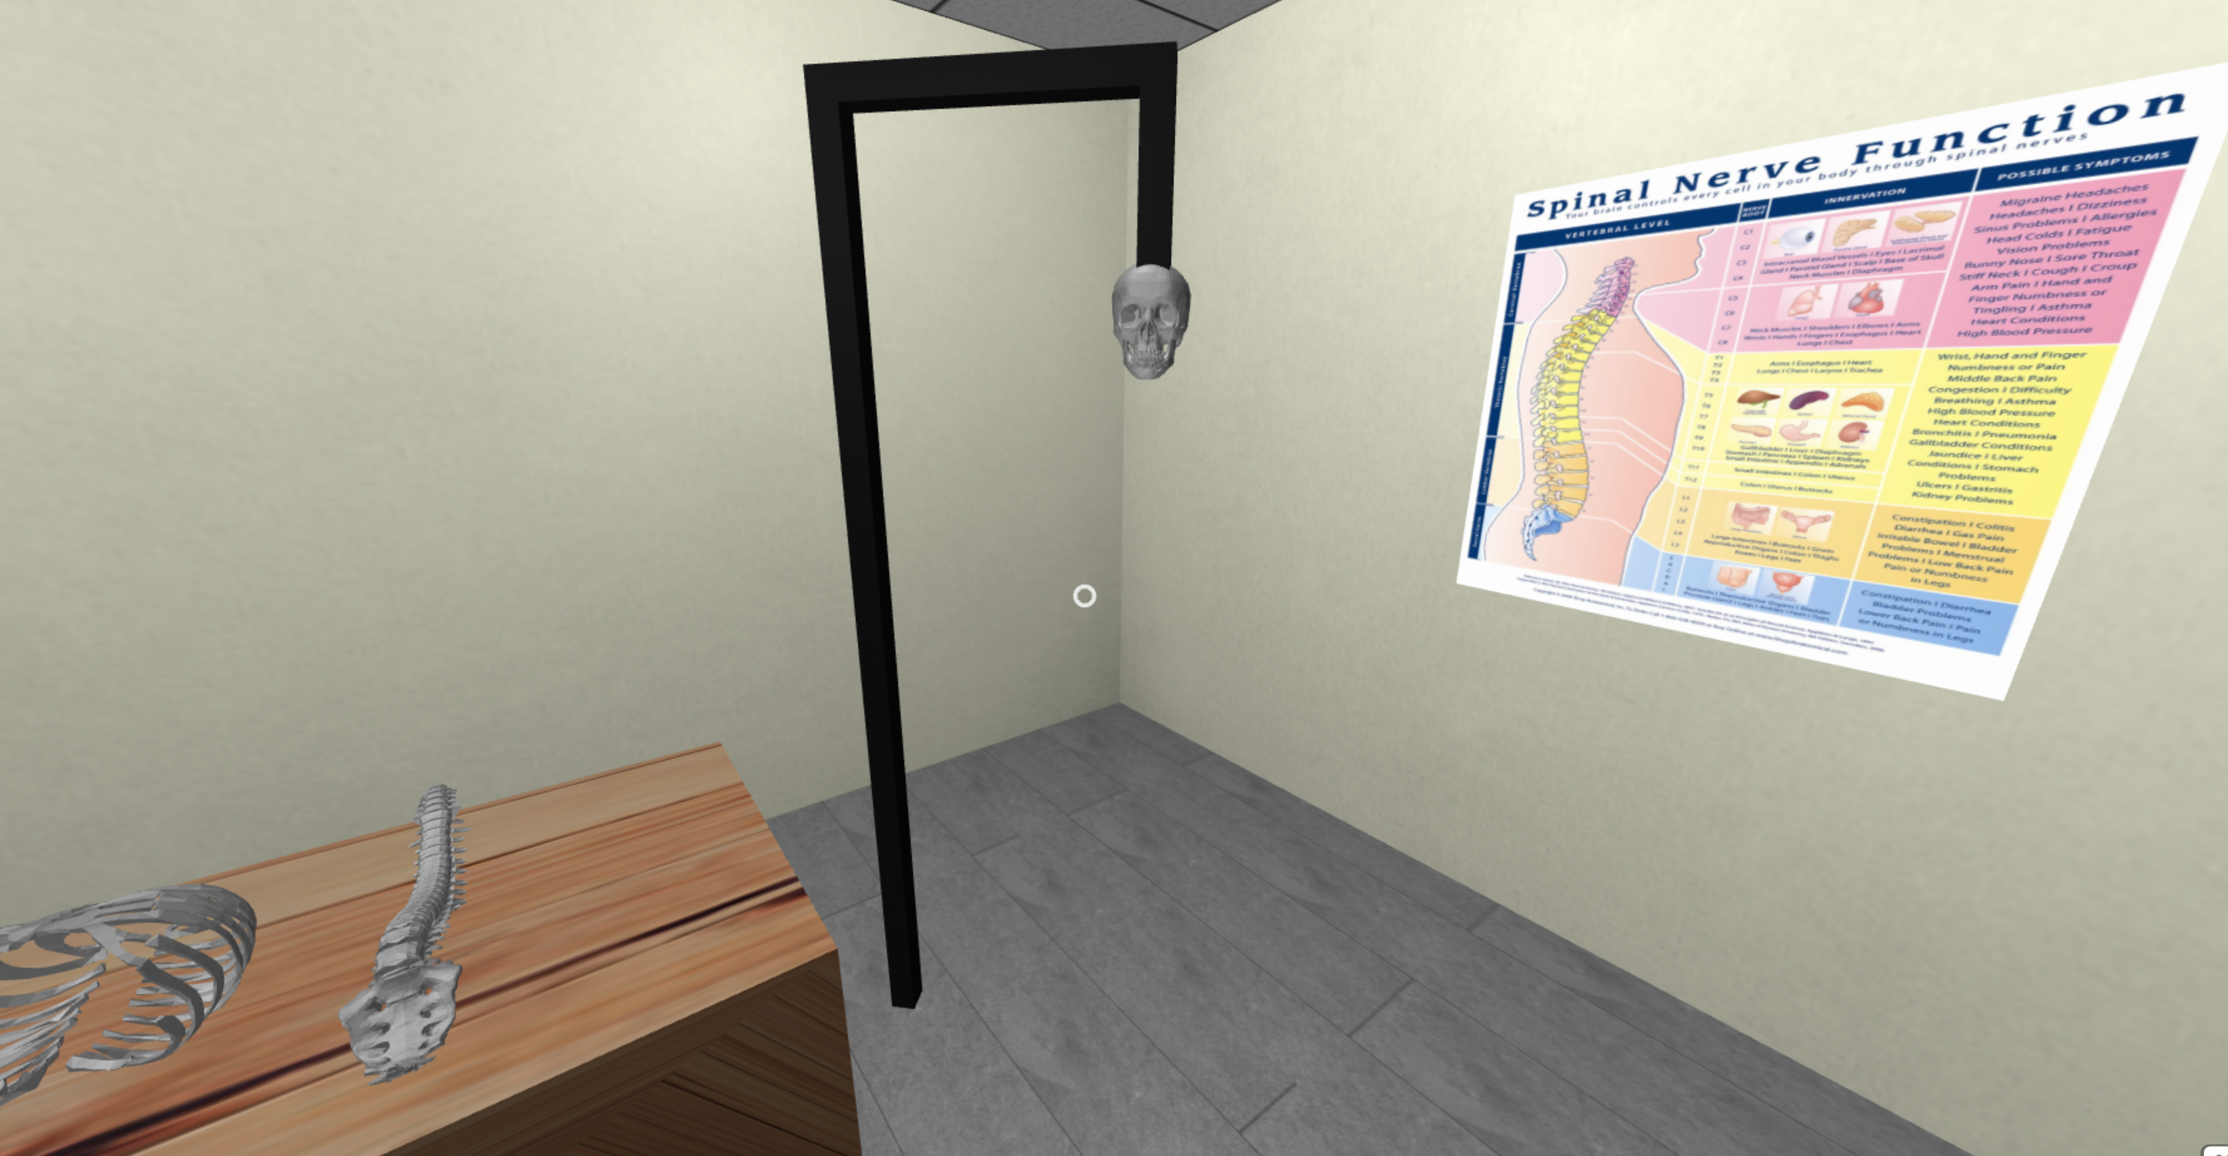
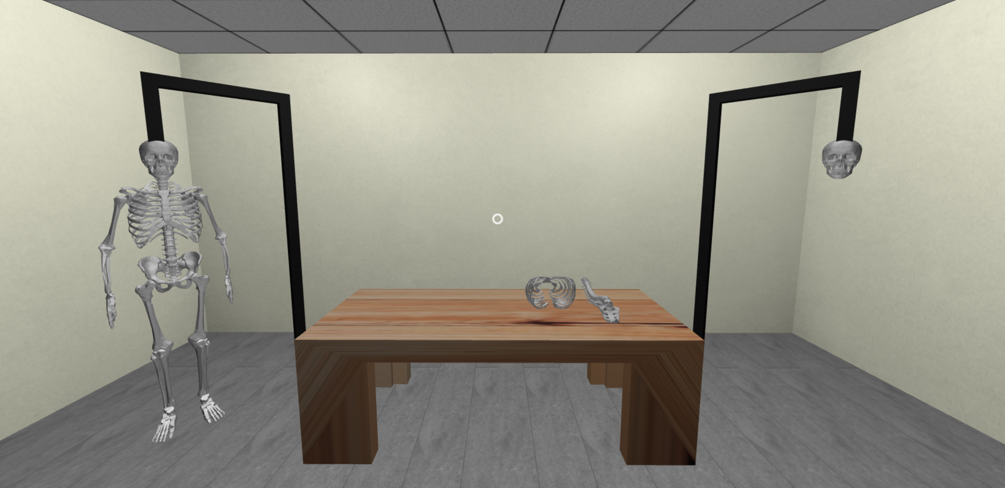
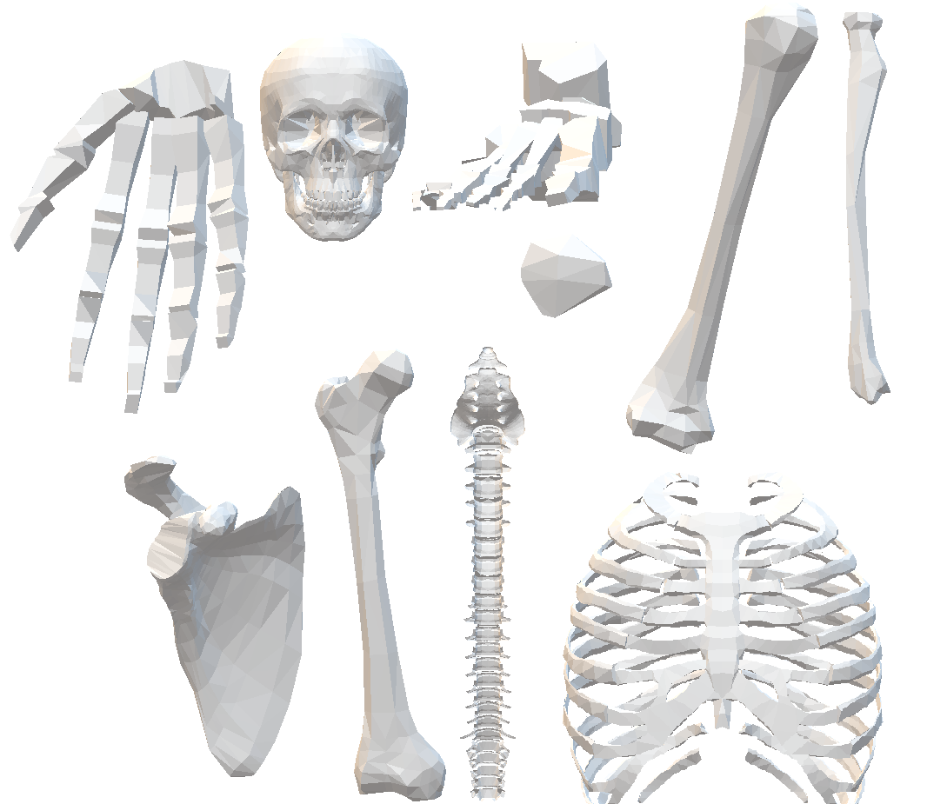
The Design
Skeleton modeled in Blender [2]
These individual bones are then used to design the game
Game objective is to assemble the skeleton

Slide 4
Technologies
Blender [2]: free and open-source 3D computer graphics tool for creating visual effects, and 3D models
Unity [3]: cross-platform game engine to create 3-dimensional, virtual reality, and augmented reality games, as well as simulations and other experiences
Oculus rift [4]: virtual reality headset and interactive controllers

Slide 5
Plan
Basic design and ideas
Skeleton model
Bone models from the skeleton using Blender
Device set up
Unity & Oculus tutorials
Implement project using Unity

Slide 6
REFERENCES
[1] Human skeleton disassemble and assemble: https://www.youtube.com/watch?v=Gim0IKlPrkY
[2] Blender: https://www.blender.org/
[3] Unity: https://unity.com/
[4] Oculus rift: https://www.oculus.com/rift/

